Slide 1
Loan Default Prediction
Group 12: Shiyi Hua, Qiuyi Lu, Vaishnavi Kodaganti

Slide 2
How Does Lending Club Work?
Lending club
BORROWER
INVESTOR
Risk
Return
Source: Kaggle
Notes:
In 2014, it became a public company through IPO and now, it is the largest P2P lending platform in the world.

Slide 3
01. Discover business problem
02. Build model to solve problem
03. Result and Conclusion

Slide 4
01
Discover the business problem
Data Exploratory Analysis

Slide 5
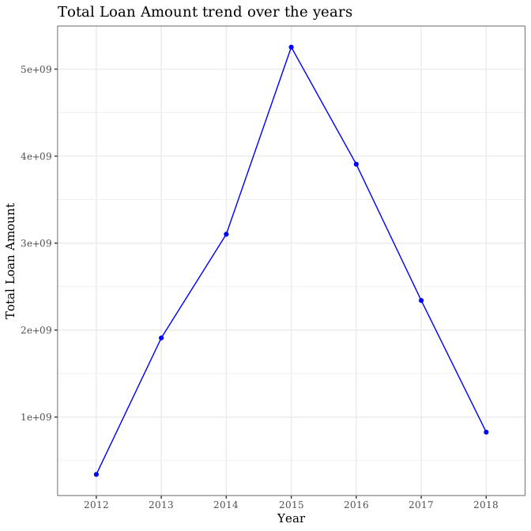
Business Probelm
Loan Amount
How has the business performed over the years ?
Notes:
How has the business performed over the years ?
We see that over the years, the business of the Lending Club was increasing till the year 2015 and then it has been continuously decreasing till 2018.

Slide 6
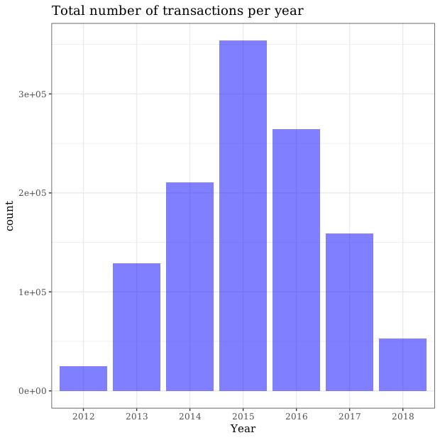
Business Probelm
Number of Transaction
Are the total number of transactions being handled on a growing or declining trend ?
Notes:
Upto the year 2015, the number of transactions handled increases and is highest for this year after which it shows a declining trend.

Slide 7

Define Default
Loan
Status
Label = 1
Label = 0
Charged Off
Fully Paid ✔
Late
Default

Slide 8
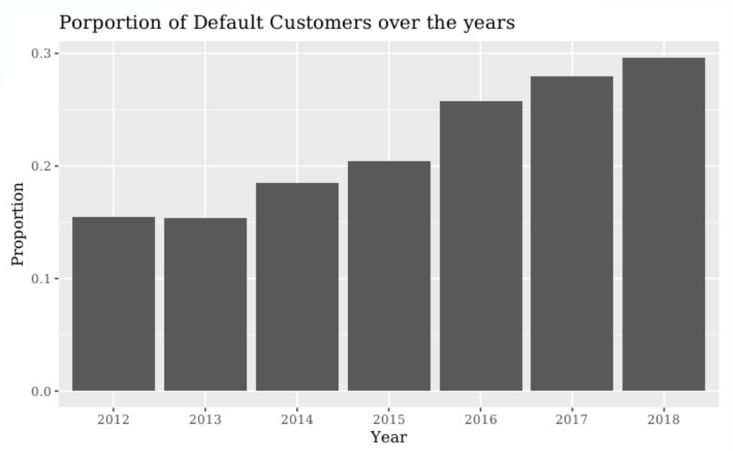
Business Problem
Default Rate
Has the Annual Default Rate of borrowers increased/decreased over the years?
Notes:
The Annual Default Rate of customers has almost continuously increased over the years.

Slide 9
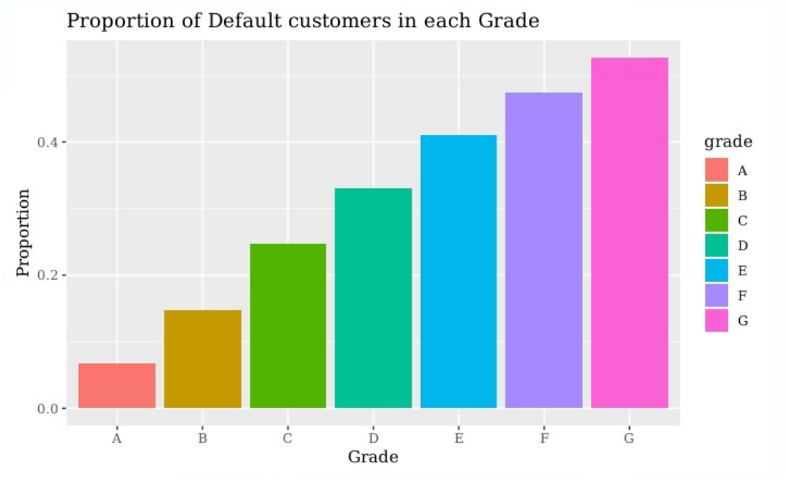
Customer Portrait of Defaulted Records
Customer Portrait
Are borrowers belonging to grade A loans less likely to
default?
Yes.
Notes:
, borrowers belonging to grade A are less likely to default. The default rate increases as the grade of loan decreases, with the highest being for grade G.
, borrowers belonging to grade A are less likely to default. The default rate increases as the grade of loan decreases, with the highest being for grade G.

Slide 10
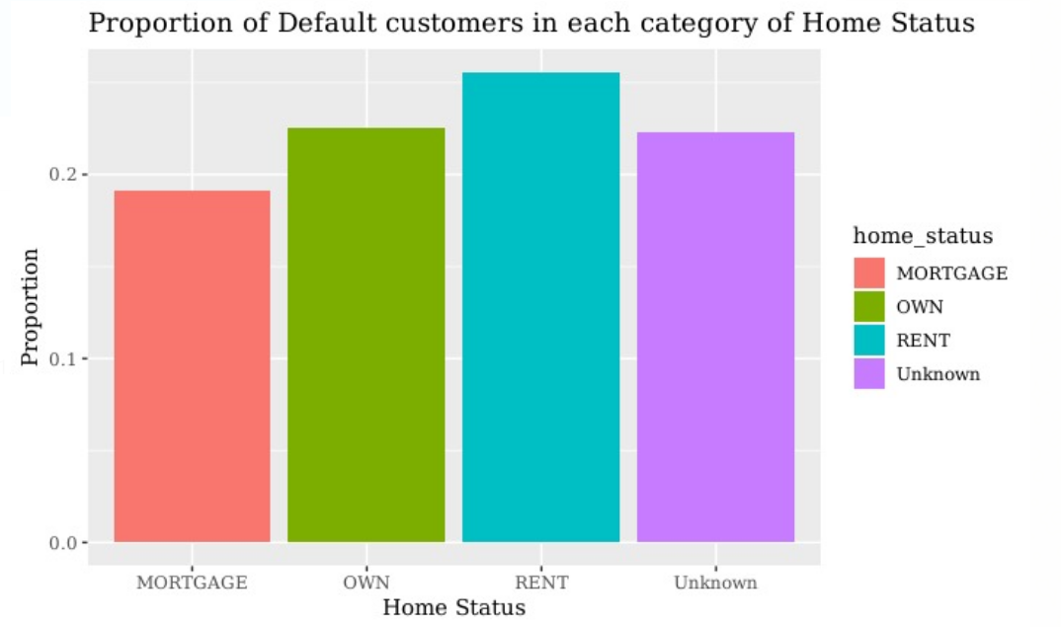
Discover the business problem
Customer Portrait
Do borrowers with Mortgage have the highest default rate?
No.
Notes:
No, borrowers having mortgage are not the ones with the highest default rate. Borrowers with rental home status have the highest default rate.

Slide 11
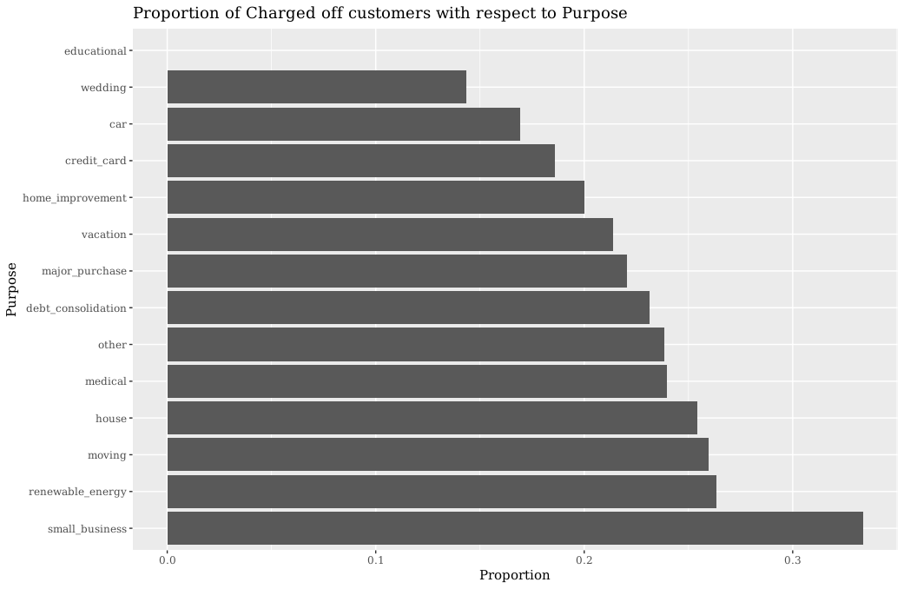
Discover the business problem
Customer Portrait
Is purpose for borrowers a
factor that influence the default?
Yes.
Notes:
No, the customers borrowing loans with small business as the purpose have the highest default rate.

Slide 12
02
Build model to solve problem
Logistic Regression &Deep Learning

Slide 13

Feature Selection & Data Cleaning
2.24m rows × 145 features 1.19m rows × 23 features
Log Transformation
Drop NA
- total accounts
- employment length
- % trades never default
Cut Numeric into Intervals
Categorization
- annual income
- # default within past 2 yrs
- % trades never default
- # charge-offs within 12 months

Slide 14
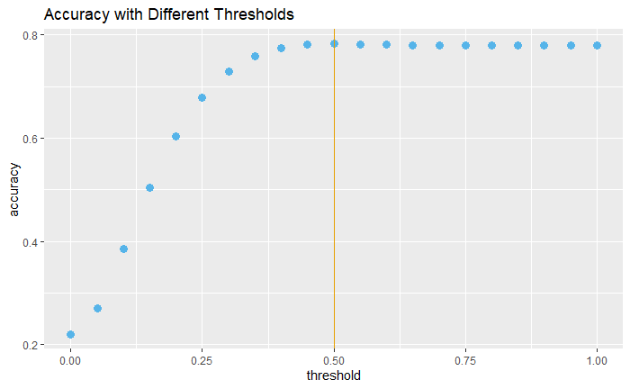

Baseline Model:Logistic Regression
Train Model
Training size: 50%
Accuracy: 78%
Detection rate:
7%
Threshold: 0.5
Reason: imbalanced dataset
(20% are label 1)
improved in model 2

Slide 15
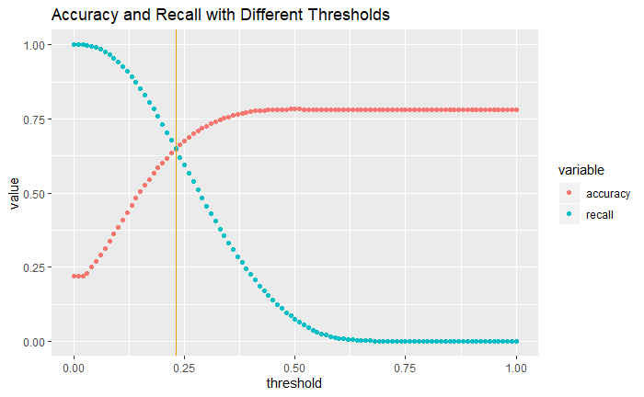
Baseline Model
Tune Model
Validation size: 25%
Threshold: 0.23
Accuracy: 65%
Detection rate: 65%

Slide 16




Baseline Model
Test Model
Test size: 25%
Among 100 truly
defaulted people, we detected 65.
Among 100 people we
predicted as default, only 35 are truly defaulted.

Slide 17
Baseline Model
What does the model tell us?
If a person …...
Borrows $15,000 for 5years
Has 2-year work experience
verified annual income $100,000
…
His likelihood of default is 33.74% > 23%.
Based on our model, we will NOT lend him any loan.

Slide 18
Model2: Logistic regression by one-hot encoding
Balanced sample:
Transform factor to numerics
[Morgage, Rent, Unkown] One-hot encoding [0,1,0]
Income Standardize (Income-mean)/sd
Credit grade (A,B,C…) Ordinal encoding [1,2,3…]
1
1
0
1
0
Create a new feature: monthly income/monthly debt
Tune the parameters (penalty='l1’ to prevent overfitting)

Slide 19






Model2 outperformed Baseline
Probability < 0.4
among 100 defaulted people, we detected 81
Probability > 0.4
Notes:
Baseline:
Accuracy: 0.65
Recall:0.6524
Precision: 0.345
F1:0.452
F2:0.554

Slide 20
Model2 outperformed Baseline
* on test data

Slide 21

Deep Learning Model
Sexy ?
We
Logistic
Regression

Slide 22

Model3:Deep Learning Model
2 hidden layers
first: 15 nodes
second: 5 nodes
Result is not exciting
Accuracy: 0.6581 Detection: 0.663
Features you see
Not better than model 2
Hidden features

Slide 23
03
Result and Conclusion
Select Logistic Regression model as final model

Slide 24
Select model 2 as final model
What is the ranking of key features?
Interest rate
Debt-covered ratio
Sub-grade
Annual income
Total-account
Loan amount
Percentage never delinquent
Employ length
Term
(By Random Forest Classifier)

Slide 25

Conclusion
Build a logistic regression model to predict the default rate.
Although the accuracy is 60%, the detection rate (80%) is high.
We found the most important features that determine a person’s default probability. Helpful to manually review applicants.
Collect more features that can measure the ability to pay.
(e.g. past spending)
Apply more advanced model to improve accuracy.(Xgboost)

Slide 26
THANK YOU
PPT模板下载：www.1ppt.com/moban/ 行业PPT模板：www.1ppt.com/hangye/
节日PPT模板：www.1ppt.com/jieri/ PPT素材下载：www.1ppt.com/sucai/
PPT背景图片：www.1ppt.com/beijing/ PPT图表下载：www.1ppt.com/tubiao/
优秀PPT下载：www.1ppt.com/xiazai/ PPT教程： www.1ppt.com/powerpoint/
Word教程： www.1ppt.com/word/ Excel教程：www.1ppt.com/excel/
资料下载：www.1ppt.com/ziliao/ PPT课件下载：www.1ppt.com/kejian/
范文下载：www.1ppt.com/fanwen/ 试卷下载：www.1ppt.com/shiti/
教案下载：www.1ppt.com/jiaoan/ PPT论坛：www.1ppt.cn

